Slide 1
Web Search Engine
Turf Booking Platform…….
Group members: -
Ratan Singh- ( 9511 )
Aarush Wasnik- ( 9517 )
Guided by :- Prof. Archana lopes

Slide 2
Agenda
Introduction
Problem statement
Objective
Need Of Search Engine
Extensive Literature Survey
Problem With Existing System
Proposed Methodology
Innovativeness in the Proposed Solution
Software Requirement
Progress till last semester
References

Slide 3
INTRODUCTION
A web search engine that will be used exclusively to sort fields at the most affordable rates.
Some insight: -
Compare the numerous deals offered on turf websites.
Host various turf websites.

Slide 4
PROBLEM STATEMENT
Users are not able to avail the best-sorted deals according to their needs and pocket size at a one-stop platform.
In this rapidly developing world, the area available for outdoor activities has been reducing day by day. So, people prefer to book a play inside the turf. But the main problem faced by the sports enthusiast is that they don’t have enough resources or a single website where they can browse and book their favourite and best-offered deal to them without doing any manual work for a longer duration of time. So we decided to build a search engine that will be specifically used for sorting turf with their need.

Slide 5
Objective
To allow users to search and view information about Turf online using our search engine.
Using various filters (such as rating, amenities, and price range) as keywords to find the most accurate search result.
Using a sorting algorithm with condition term frequency of filter keyword.

Slide 6
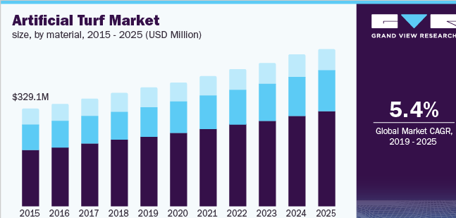
NEED FOR A SEARCH ENGINE
One stop platform where user can find the satisfactory output from the search engine.
Rising demand for the turf, but no application where user can compare the turf in term of space , price , ratings .
Global Artificial Turf Market 2021-2025:- The analyst has been Monitoring the artificial grass turf market and it is poised to grow by Rs 104 crore during 2021-25 progressing at the CAGR of over 5.45% during the forecast period.

Slide 7
Extensive LITERATURE SURVEY
Sr. No. | Title | Abstract | Advantage
1. | “Online Playground Booking System” | Online booking system and identification of the user by QR Scanning. | - Identification By QR Scanning.
2. | “ Design and Implementation of Online Booking System of University Sports Venues ” | Booking of Sports Venues inside the University where there is more than one sports venue. | Personal Care Modules. Message Board Function.
3. | “On The Design of Web-Based Information and Booking System For Futsal Field Rental Business” | Football Field Renting Application in which Football Field owners can promote their field. | - Google Map API.

Slide 8
RESEARCH GAP / PROBLEMS WITH EXISTING SYSTEMS
“Online Playground Booking System”:- The existing system doesn’t have any facilities for various filters such as location, price, and much more.
“Design and implementation of an online booking system for university sports venues”:- This system gives users the facilities of booking venues for a particular duration but this system was restricted to that particular university i.e. it was used to book venues in that university and not universally.
“On the design of web-based information and booking system for a futsal field rental business”:- This system fails to provide the facility of booking the turf rather than it provides users the knowledge of various playground available in the locality and help in the rental business.

Slide 9
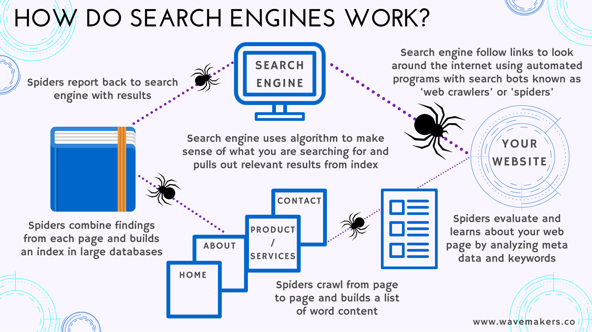
PROPOSED METHODOLOGY
The Search Engine works in the following Steps:-
Input ( Query) from User.
Crawl → Web Spider.
Index.
Ranking Algorithm.
Shows Output.

Slide 10
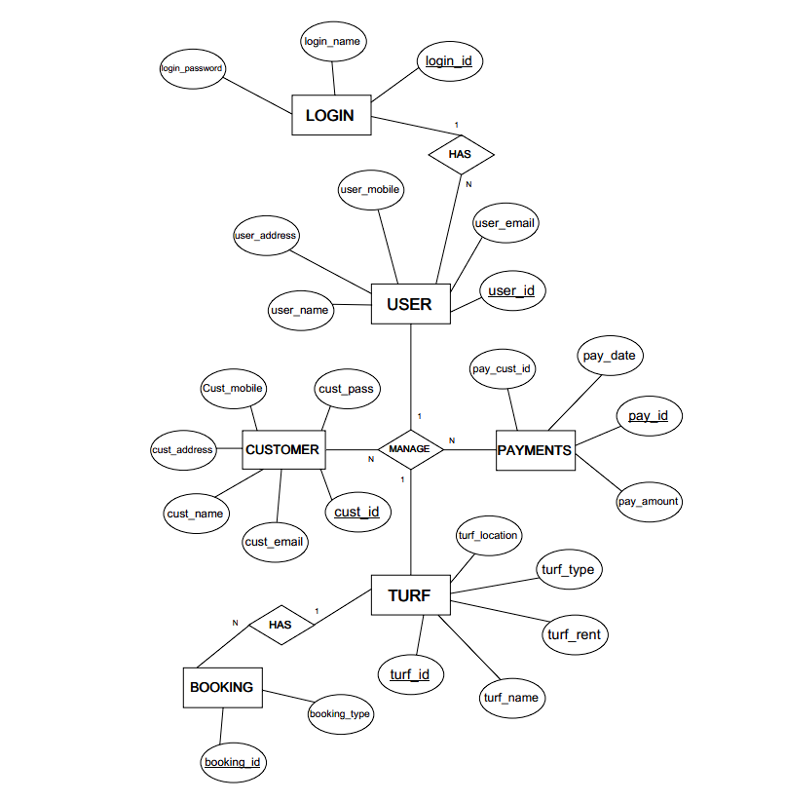

Slide 11
INNOVATIVENESS IN PROPOSED SOLUTION
The facility of a Search Engine for specifically booking a playground is not available in the current area of the turf booking system.
A search engine with various filters will help find the accurate result based on the need in terms of price, location, and amenities.
An application that will sort all the existing websites of turf and will show the best deal for the user.
The system will provide a glance at recently booked turf in a particular location with the ratings provided by the users.

Slide 12
Software requirement
Frontend: -
Backend: -
HTML
CSS
JavaScript
NodeJS
ExpressJs
MongoDB

Slide 13
Progress till last semester
Till last semester we where able to complete frontend development which included HTML and CSS and started with backend and were able to connect MongoDB .
After the project presentation with external examiner we received some feedback which were needed to be improved.
Feedback from the External Examiner were as follows:-
Need to work on the CSS.
Add additional features of most booked Turf field.
Alignment of the Login form.
Optimize the search engine to give rating for the most booked turf.

Slide 14
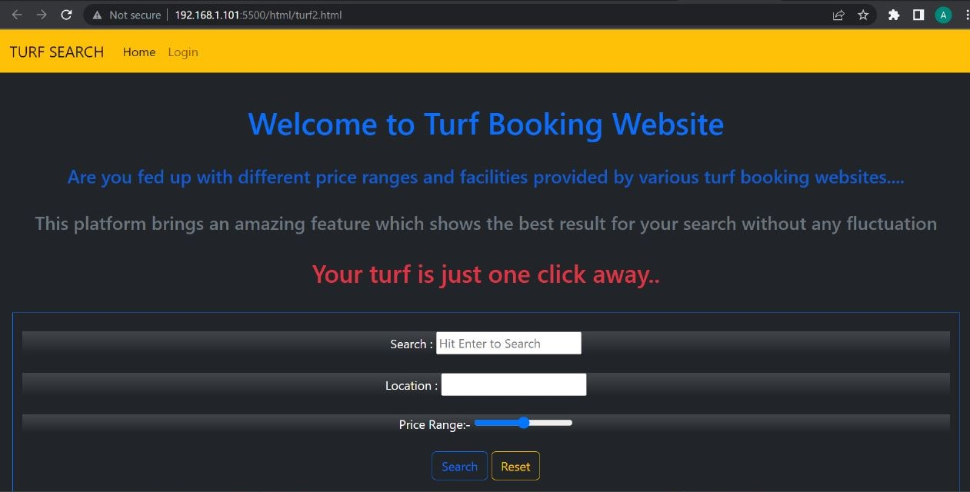
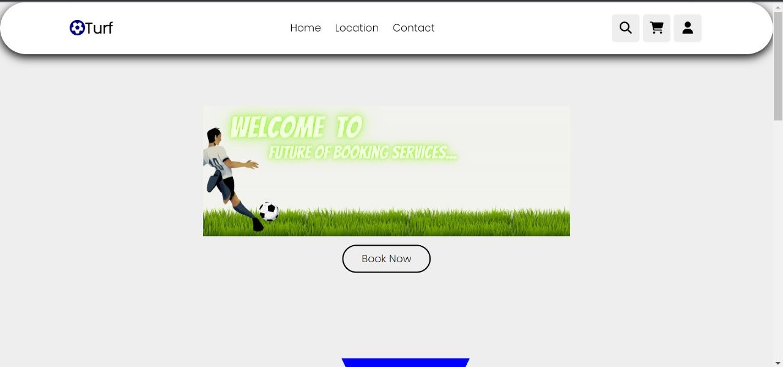
Comparison Of the INTERFACE
Index Page before
Index page after

Slide 15
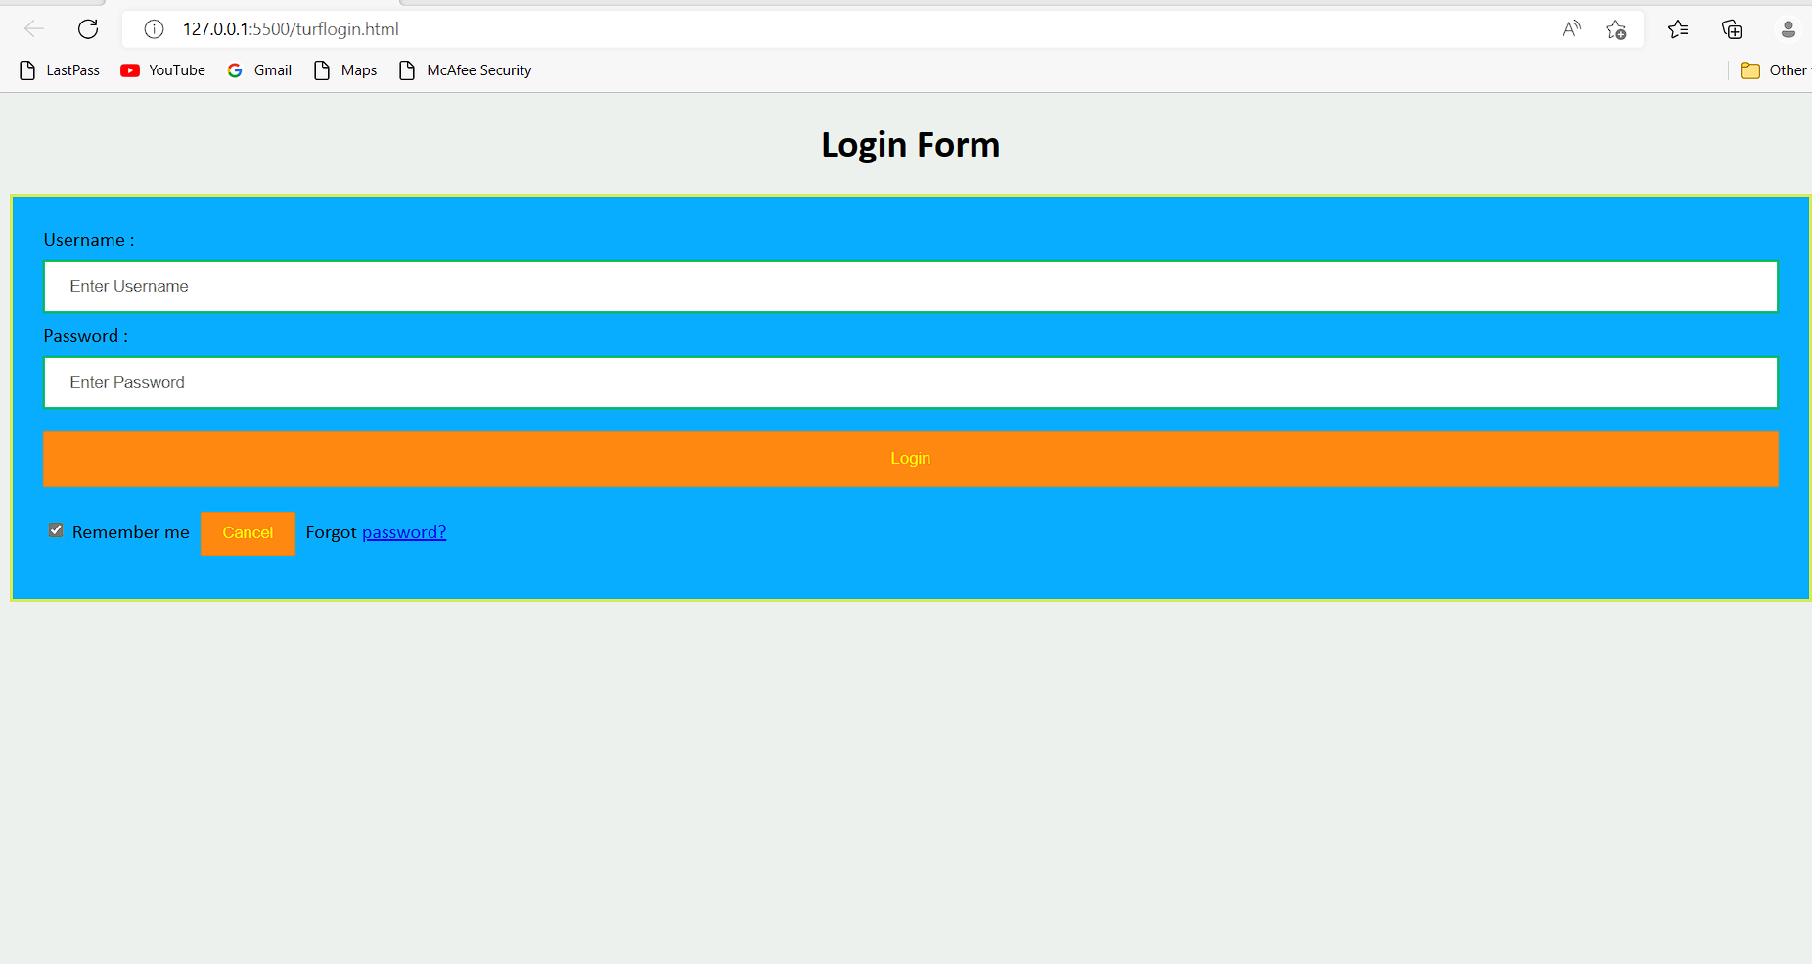
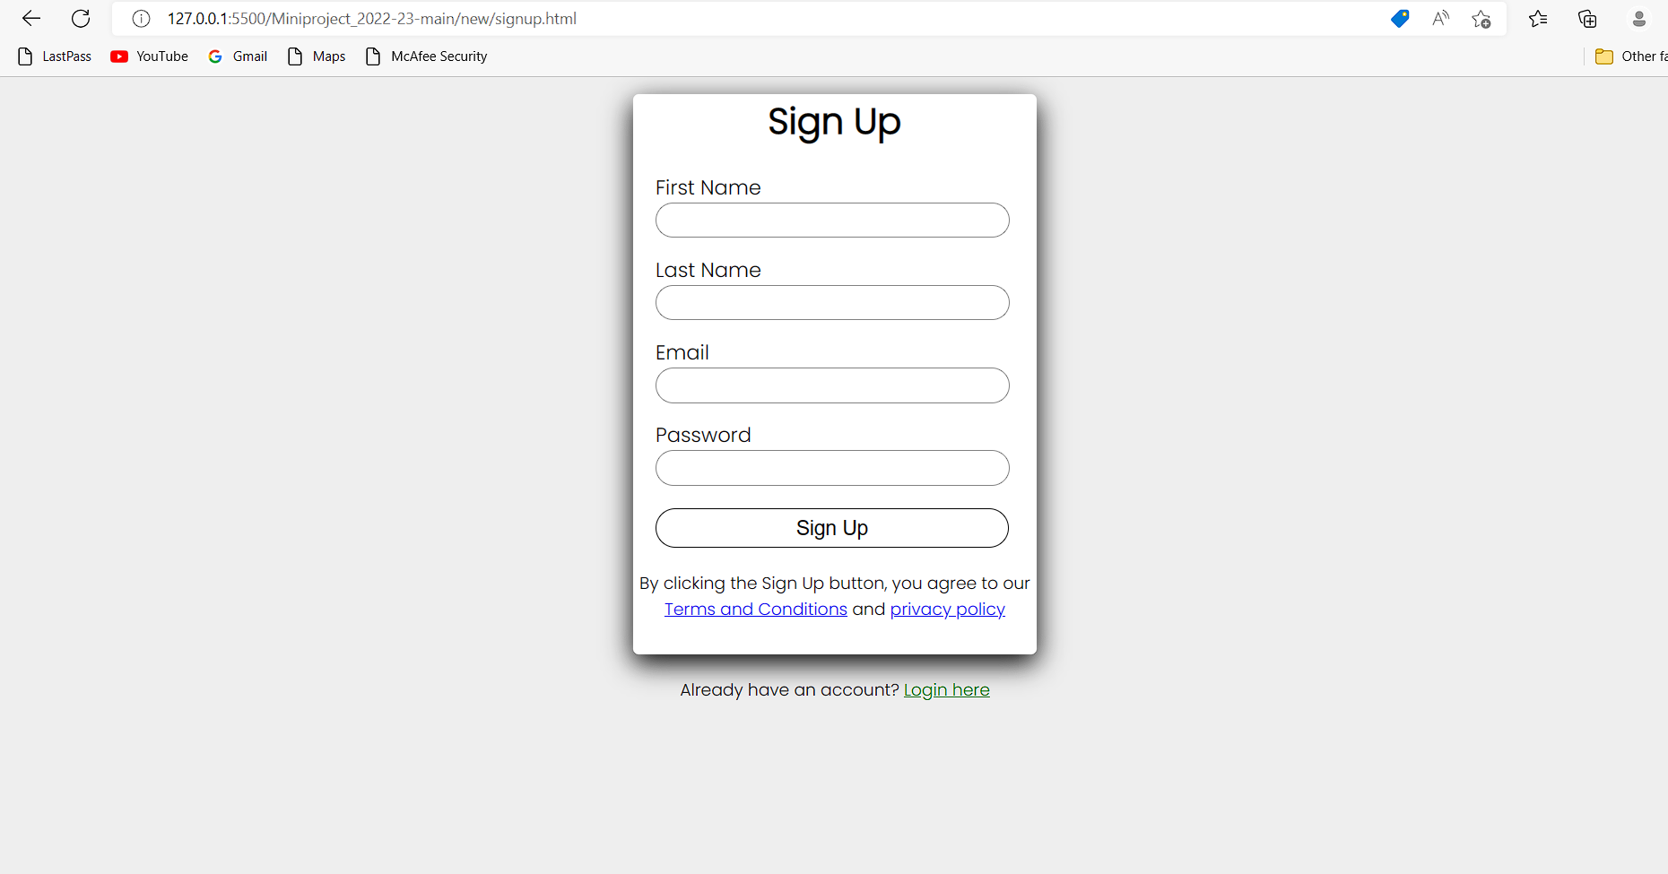
Login form
BEFORE AFTER

Slide 16
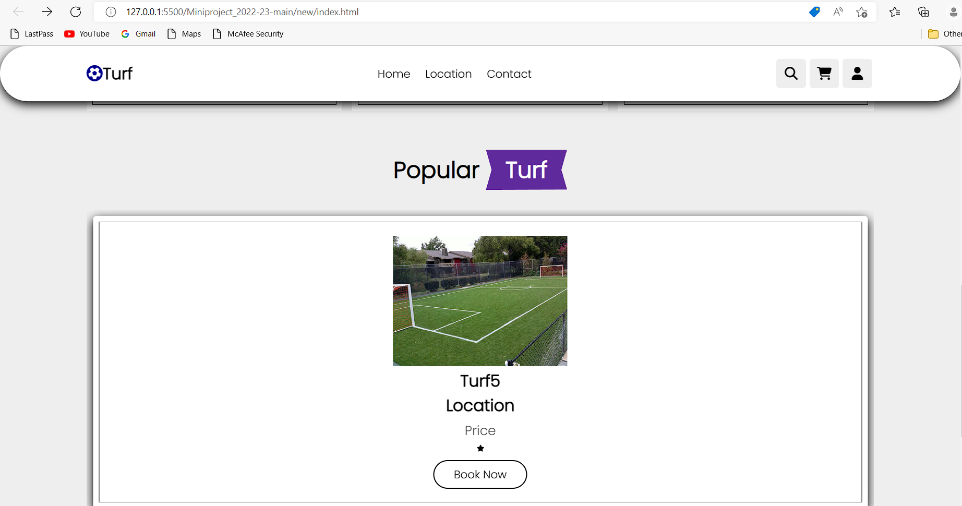
Additional Features
For now it will be set by us and the stars are been provided us..
As soon we finished with the backend connection we will be optimizing it and start with recommendation system.

Slide 17
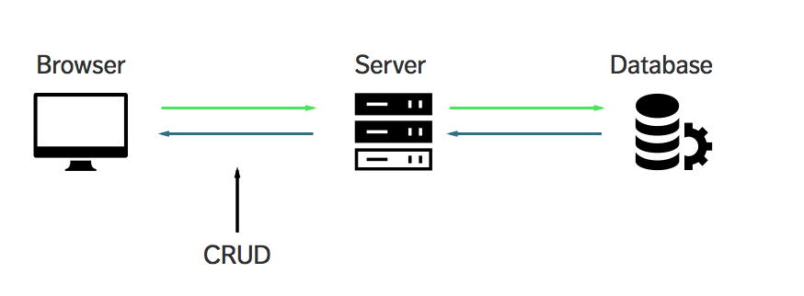
Backend CONNECTIONS Using Express.js AND Mongo dB:-
Serving static files using “express.static”.
Creating different routes i.e. (/) for different static files.
Using Different HTTP method to send request through server.
Understanding URL parameter and queries.

Slide 18
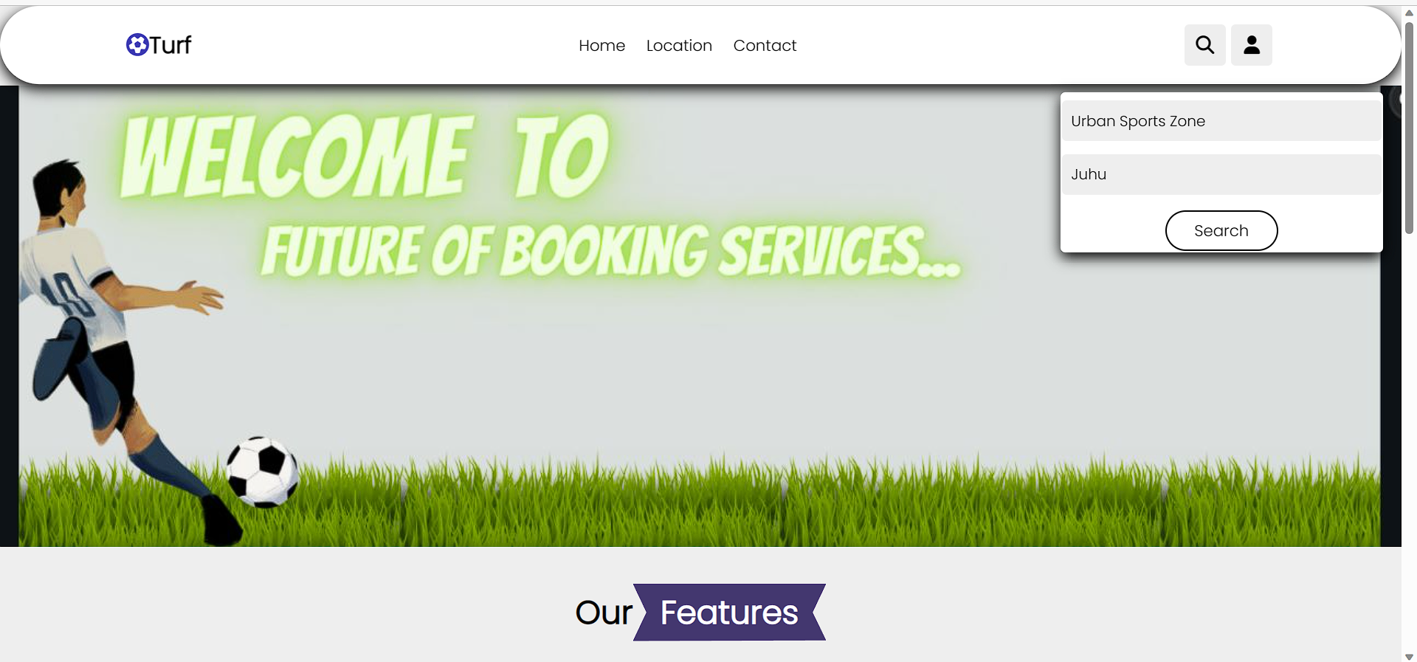
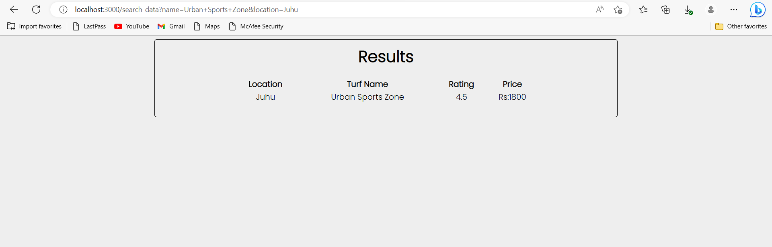
Search by Name and Location

Slide 19
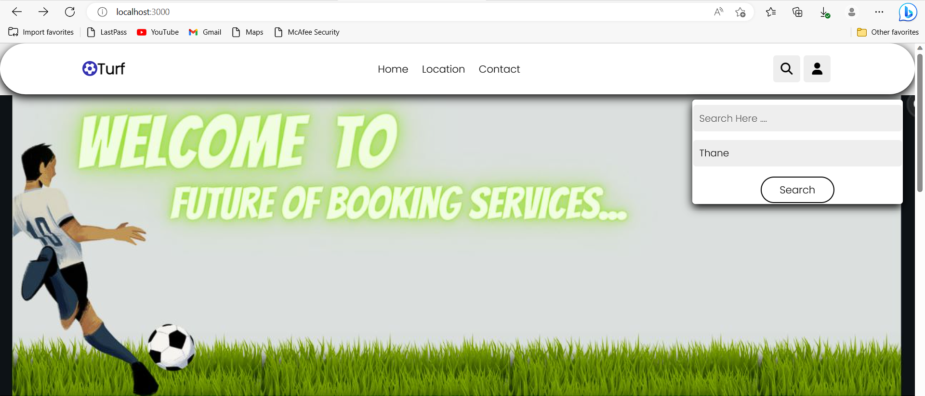
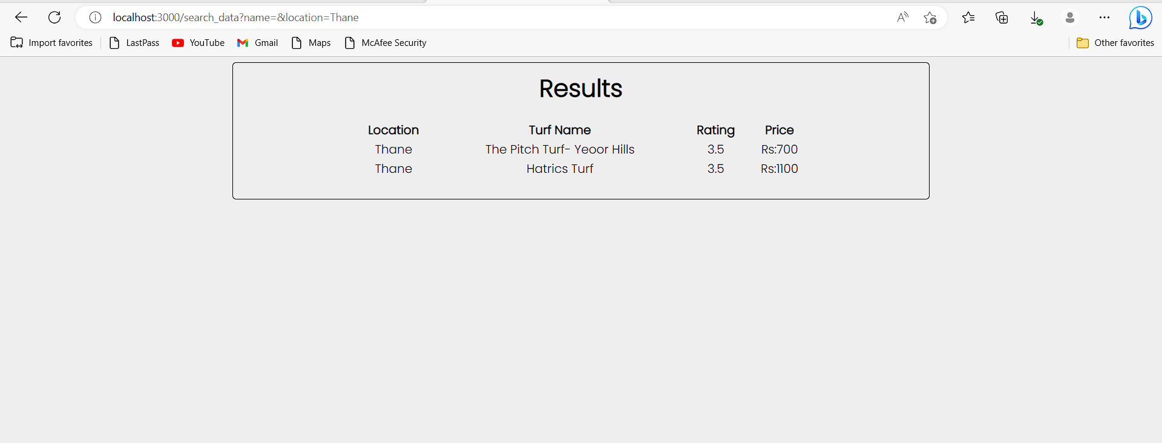
Search by Location

Slide 20
Future Enhancement:- Recommendation System
Cosine Similarities:-
Cosine similarity is a metric, helpful in determining, how similar the data objects are irrespective of their size. We can measure the similarity between two sentences in Python using Cosine Similarity.
Geodesic Distance:-
It is the length of the shortest path between 2 points on any surface. In our case, the surface is the earth.
Count Vectorizer:-
Count Vectorizer is a great tool provided by the scikit-learn library in Python. It is used to transform a given text into a vector on the basis of the frequency (count) of each word that occurs in the entire text

Slide 21
references
[1] Michael M. Beveira, Sandra Jeyes C, Vishnu V. “Online Playground Booking System”. C CO - nihb.ac.in
[2] Can Li, Junjie Li, Hongxiang Cao, and Zhan Meng. “Design and implementation of an online booking system for university sports venues.” MATEC Web of Conferences, 100:02024, 01 2017.
[3] Moechammad Sarosa, Verda Nurohmansah, Wahyu Permana, and Yoyok Heru. “On the design of web-based information and booking system for a futsal field rental business.” International Journal of Computer Applications Technology and Research, 7:225–230, 06 2018

Slide 22
Thank you!

